Slide 1
Predicting The Crime a Victim is Most Susceptible to in LA
By Connor Friedman
Dr Yilmaz Period 1
TJ Machine Learning 1
10/30/2024

Slide 2
Project Overview
A tool used to gage what category of crime one might be most susceptible to in LA based off of data from previous arrests
Enables tourists to effectively prepare themselves and avoid the type of crime they’re most susceptible to when visiting Los Angeles
My goal was to create a model that could accurately predict what category of crime one is most susceptible to based off of a description of the victim and the location of the Victim.

Slide 3
01
Dataset

Slide 4
Overview of Dataset
A continuously updated dataset provided by the LAPD on catalog.data.gov.
Contains information about every Arrest made from January 1st 2020 to October 16th 2024.
The Class Attribute, Crm_Cd_Desc, or crime code description, will be the type of crime we’re trying to predict a victim is most susceptible to

Slide 5
Dataset Features
Date of Occurence (date in which crime occured)
Date Crime was Reported
Area (an internal coding system in the LAPD)
Area Name
Part 1-2
Crm Cd (an internal coding system for the type of crime that occured)
Crm Cd Desc (what type of crime was committed)
Mocodes (an internal coding system for the type of punishment received for crime)
Victim Descent, Sex, and Age (information describing the victim)
Weapon Used Cd, Weapon Description (internal coding and a description of the weapon used in a violent crime)
Status, Status Desc (another internal coding system along with the status of the conviction)
Location, Cross Street (general information about the exact location the crime took place)
Latitude and Longitude

Slide 6
02
Preprocessing

Slide 7
Cutting Down the Dataset
Dataset started with a shocking size of 250 megabytes, which was way to large for WEKA to handle
Only kept instances of crimes that took place in 2024
Got rid of instances that simply didn’t provide any useful information for my model, consisting of crimes without victims and therefore no tangible data to use.

Slide 8

Data Cleaning
Got rid of attributes that didn’t provide any useful information when creating my classification model, essentially consisting of features that were only used for internal filing
Part 1-2 (still don’t know what this data was lol)
Crm Cd 1-4
Reported District Number
Also had to clean up the strings within the dataset for WEKA to properly interact with the dataset

Slide 9
Reducing # of Described Crimes
The original dataset contained a shocking 142 different crimes to use as the class values, which would’ve made tracking accuracy, false positives, and area under the ROC curve impossible.
Created 9 distinct categories of crime, fitting each of the 142 different crimes into each category:
Theft
Domestic/Intimate Violence
Assault
Vehicle Crimes
Vandalism and Property Damage
Fraud and Financial
Threats and Harassment
Burglary
SA

Slide 10
Predicting The Crime a Victim is Most Susceptible to in LA
By Connor Friedman
Dr Yilmaz Period 1
TJ Machine Learning 1
10/30/2024

Slide 11
Project Overview
A tool used to gage what category of crime one might be most susceptible to in LA based off of data from previous arrests
Enables tourists to effectively prepare themselves and avoid the type of crime they’re most susceptible to when visiting Los Angeles
My goal was to create a model that could accurately predict what category of crime one is most susceptible to based off of a description of the victim and the location of the Victim.

Slide 12
01
Dataset

Slide 13
Overview of Dataset
A continuously updated dataset provided by the LAPD on catalog.data.gov.
Contains information about every Arrest made from January 1st 2020 to October 16th 2024.
The Class Attribute, Crm_Cd_Desc, or crime code description, will be the type of crime we’re trying to predict a victim is most susceptible to

Slide 14
Dataset Features
Date of Occurence (date in which crime occured)
Date Crime was Reported
Area (an internal coding system in the LAPD)
Area Name
Part 1-2
Crm Cd (an internal coding system for the type of crime that occured)
Crm Cd Desc (what type of crime was committed)
Mocodes (an internal coding system for the type of punishment received for crime)
Victim Descent, Sex, and Age (information describing the victim)
Weapon Used Cd, Weapon Description (internal coding and a description of the weapon used in a violent crime)
Status, Status Desc (another internal coding system along with the status of the conviction)
Location, Cross Street (general information about the exact location the crime took place)
Latitude and Longitude

Slide 15
02
Preprocessing

Slide 16
Cutting Down the Dataset
Dataset started with a shocking size of 250 megabytes, which was way to large for WEKA to handle
Only kept instances of crimes that took place in 2024
Got rid of instances that simply didn’t provide any useful information for my model, consisting of crimes without victims and therefore no tangible data to use.

Slide 17
Data Cleaning
Got rid of attributes that didn’t provide any useful information when creating my classification model, essentially consisting of features that were only used for internal filing
Part 1-2 (still don’t know what this data was lol)
Crm Cd 1-4
Reported District Number
Also had to clean up the strings within the dataset for WEKA to properly interact with the dataset

Slide 18
Reducing # of Described Crimes
The original dataset contained a shocking 142 different crimes to use as the class values, which would’ve made tracking accuracy, false positives, and area under the ROC curve impossible.
Created 9 distinct categories of crime, fitting each of the 142 different crimes into each category:
Theft
Domestic/Intimate Violence
Assault
Vehicle Crimes
Vandalism and Property Damage
Fraud and Financial
Threats and Harassment
Burglary
SA

Slide 19
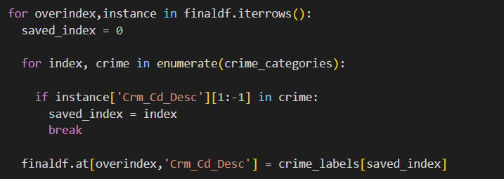

Slide 20
03
Attribute Selection and Classifiers

Slide 21
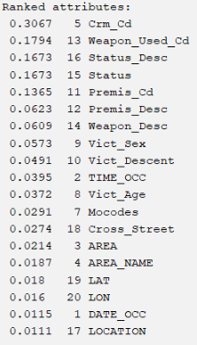
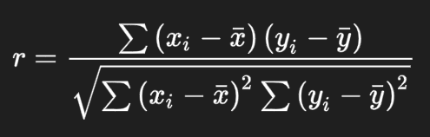
CorrelationAttributeEval
Threshold - 0.04

Slide 22
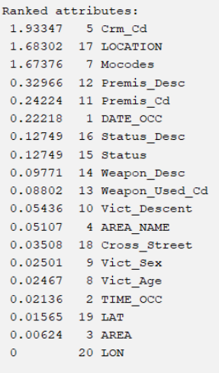
InfoGainAttributeEval
Similar to the correlation evaluator, this attribute selection algorithm evaluates the worth of an attribute by measuring and ranking its information gain with respect to the class (the higher ranked values contain more information useful to the classification model)
Threshold - 0.1

Slide 23
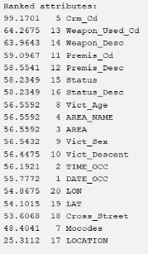
OneRAttributeEval
For each attribute
For each value of the attribute
count frequency of each class
find the most frequent class
make rule: assign that class to this attribute-value
Compute the error rate of the rules (of this attribute)
Choose the rules with the smallest error rate
Threshold - 56.5592

Slide 24
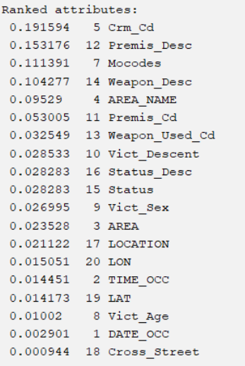
ReliefFAttributeEval
Evaluates the ‘worth’ of an attribute by repeatedly sampling an instance and considering the value of the given attribute for the nearest instance of the same class and the nearest instance of a different class.
Threshold - 0.025

Slide 25
Intuition Attribute Selector
Time of the occurred crime
Date of the occurred crime
Victim Age
Victim Sex
Victim Descent
Area
Name of Area

Slide 26
Classifiers
J48 - A decision tree algorithm that utilizes entropy to both gather information and construct decision trees. The algorithm calculates the information gain for each attribute, and attributes with the highest yield of information are selected to be nodes for the tree.
Naive Bayes - A probabilistic classification model that operates under the principles of the Bayes theorem. This model assumes that all attributes in the class are independent of each other given a class label, calculating the probability of each class according to a set of input attributes, then predicts the class with the highest resulting probability.
Random Forest - Utilizing a large set of independent and evenly weighted classification trees, Random Forest utilizes the output of each instantiated tree to determine a classification for the entirety of the model.
OneR (again) - Just like its attribute selection counterpart, The OneR classification model creates a single rule based on the feature that best classifies the data, selecting the feature with the fewest classification errors. It then assigns classes based on the most frequent class for each value of that feature.

Slide 27
03
Results and Discussion

Slide 28
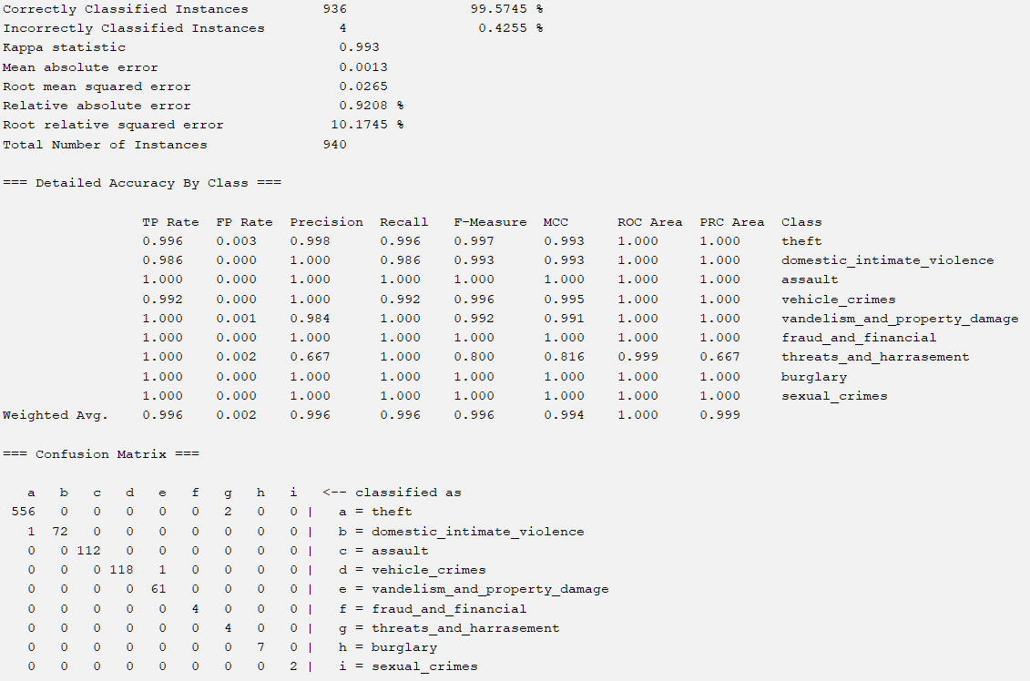
Best Overall Classification Model:
Correlation Attribute Evaluator along with the J48 classification model
Accuracy: 99.57%
TP Rate: 0.996
FP Rate: 0.003
AUC: 1.000

Slide 29
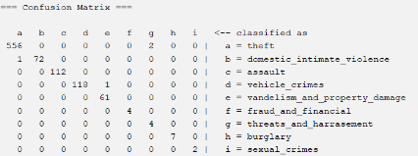

Slide 30
Conclusion and Future Work
Overall this project really surprised me with it’s results, as the combination of attributes most correlated to the category of crime were not what I was expecting
The Intuition attribute selection model did by far the worst, with the four models produced having an average accuracy of around 55%, atrocious in comparison to the rest of my models
Overall, if I were to pursue this project in the future I would definitely find a dataset with:
Much cleaner data so that preprocessing doesn’t take up half of my time
More data regarding the perpetrator of the crime itself and potentially making yet another machine learning model using that information.

Slide 31
Thank You!
Do you have any questions?

